Slide 1
Capstone Project - 2
Bike Sharing Demand Prediction
Supervised ML Regression Model
Akshay Kumar Siani

Slide 2
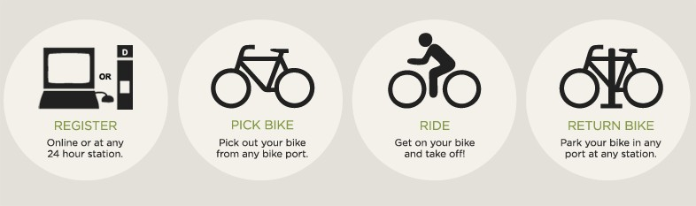
Concept of Bike Sharing
Bike-Sharing, as a new green public transportation mode, has been developed in several western cities and most of the developing countries are on the path of following the western model of bike sharing system. of the developing countries are on the path o
It is a convenient, environmentally friendly way to get around town, but has flaws too. There are certain conditions that must be met for proper implementation of this program. Bike sharing Demand is affected by multiple factors including temperature, resources and many more.

Slide 3

Let’s predict Bike Sharing Demand in Seoul
1. Defining problem statement
2. EDA and feature Engineering
3. Data Summary
4. Feature selection
5. Preparing Dataset for modelling
6. Implementing Regression models
7. Challenges
8. Conclusions

Slide 4
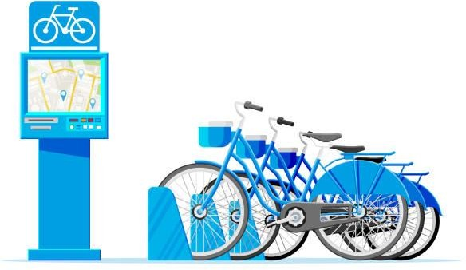
Problem statements
Prediction of demand of bike at each hour.
What factors affect bike sharing count ?
Reduce waiting time of public.
Need of machine learning to predict bike demand:
The idea of this project is to create a predictive model that identifies upcoming trends in
bike sharing demand.
It is crucial to keep in mind that machine learning can only be used to memorize patterns that are present in the training data, so we can only recognize what we have seen before. When using Machine Learning we are making the assumption that the future will behave like the past, and this isn’t always true.

Slide 5
Data pipeline
Preparing the data_1 : In this first part, we’ve done data inspection where we checked null values and duplicate observations and did multiple operations to make sure our dataset is up to the mark.
Preparing the data_2 : Checked all the features, extracted data feature to get more insight of the data. Now as dataset is ready, we moved to the next step.
EDA : In this part, in order to see the trends we did some exploratory data analysis on
the features and checked distribution of data points and correlation of variables.

Slide 6
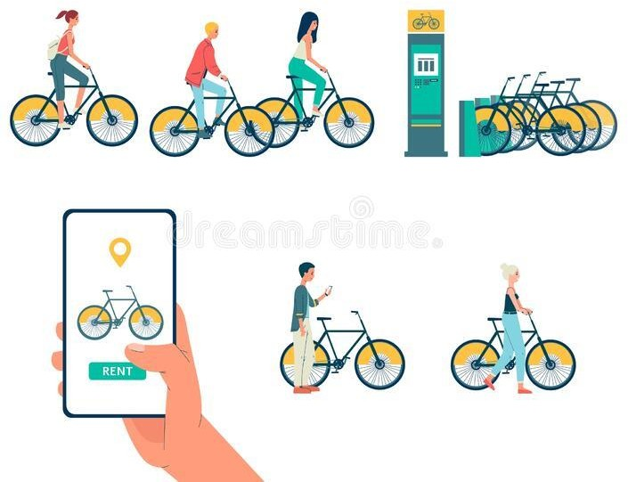
Create model : After Data preparation, We build the different supervised machine learning regression models.
Choose a Measure of Success : After implementing each model, we measure it’s accuracy by some evaluation matrices.

Slide 7
Data summary
Date - year-month-day
Rented Bike count - Count of bikes rented at each hour
Hour - Hour of he day
Temperature-Temperature in Celsius
Humidity - %
Wind speed - m/s
Visibility - 10m
Dew point temperature - Celsius
Solar radiation - MJ/m2
Rainfall - mm
Snowfall – cm
Seasons - Winter, Spring, Summer, Autumn
Holiday - Holiday/No holiday
Functional Day - Yes(
Functional Day), No(Non- Functional day)

Slide 8
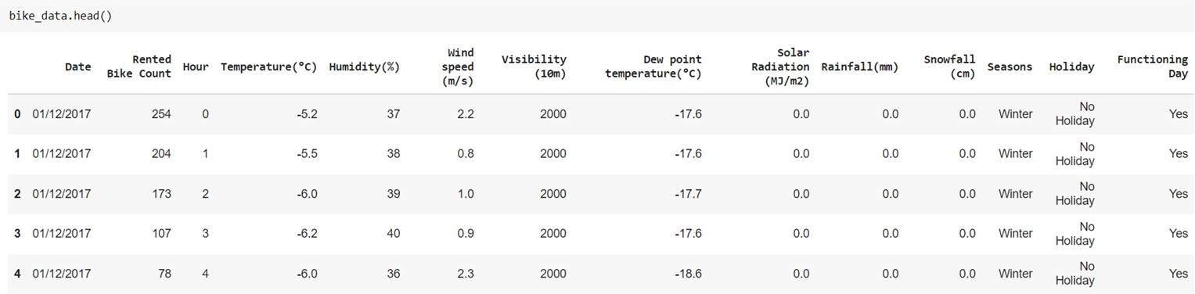
Basic Data Exploration
This Dataset has 8760 Row and 14 Columns.
The dataset has the information of 365 days(1/dec/2017 to 30/Nov/2018)
Dataset contains no null values
No duplicates values.
There are 3 categorical features ‘Seasons’, ‘Holiday’, & ‘functioning Day’.
From date column, we extract lots of features like year, month and weekdays.

Slide 9
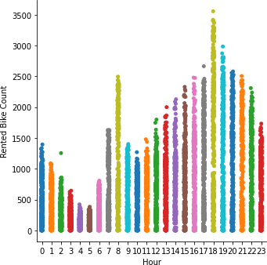
Rented bike count on various hours of the day
EDA
Demand of bike is higher at 8am and max at 6pm. i.e. during opening and closing
hours of office.

Slide 10
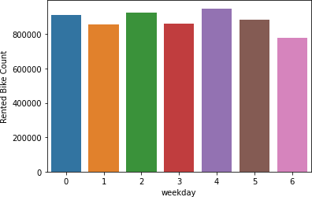
EDA - Bike count on various days of week
There is no significant difference in bike rented on various days of the weeks, but minimum bike rented on Sunday.

Slide 11
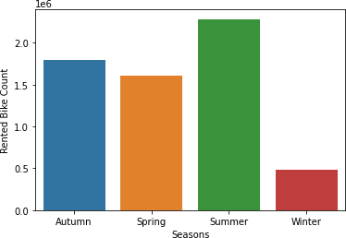
EDA – Total count of rented bike in various seasons of the year
Rented bike count is less in winter and almost consistently higher in other months.

Slide 12
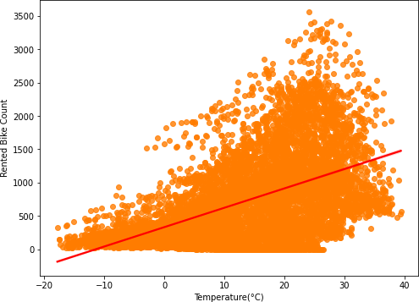
EDA - Relationship between bike count and Temperature
Temperature : Temperature is positively correlated. Rented bike count is highest
between 20 °C and 30 °C.

Slide 13
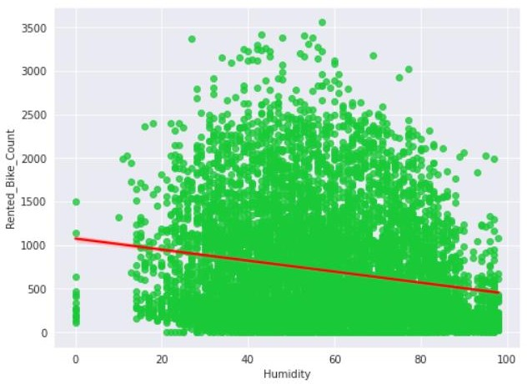
EDA - Relationship between bike count and Humidity
Humidity : Humidity is the amount of water vapor in the air. So, People preferring to
borrow bike When there is optimum humidity.(neither too high nor too low.

Slide 14
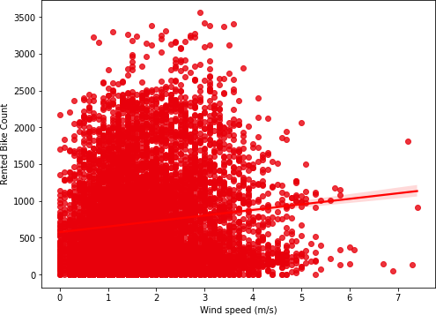
EDA - Relationship between bike count and Windspeed
Windspeed : Consumers prefer bikes when wind speed is in particular range but
looking at plot, we can conclude that wind speed doesn't affect our data much.

Slide 15
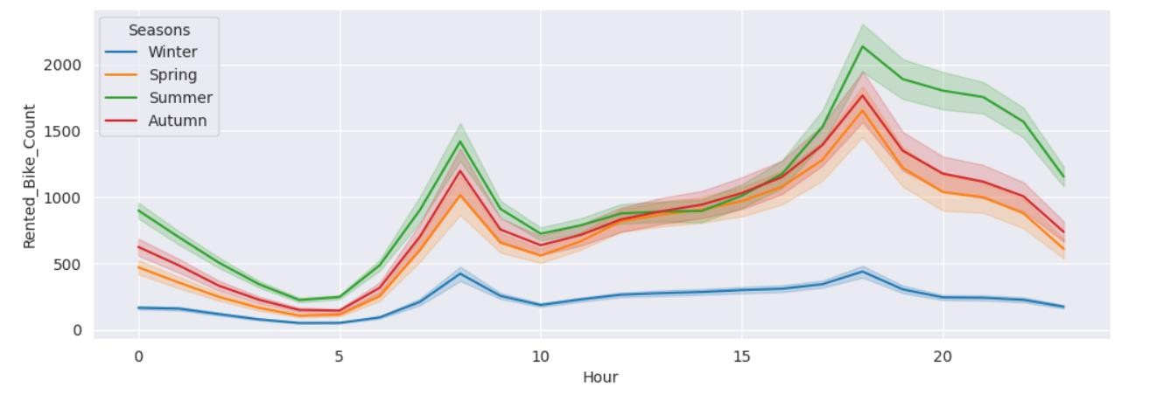
EDA - Rented bike count in different seasons
People prefer borrowing bikes more in a particular season. Rented bike count is highest in summer and least in winter. Peak demand of bike is at 8am and 6pm i.e. during office opening and closing times

Slide 16
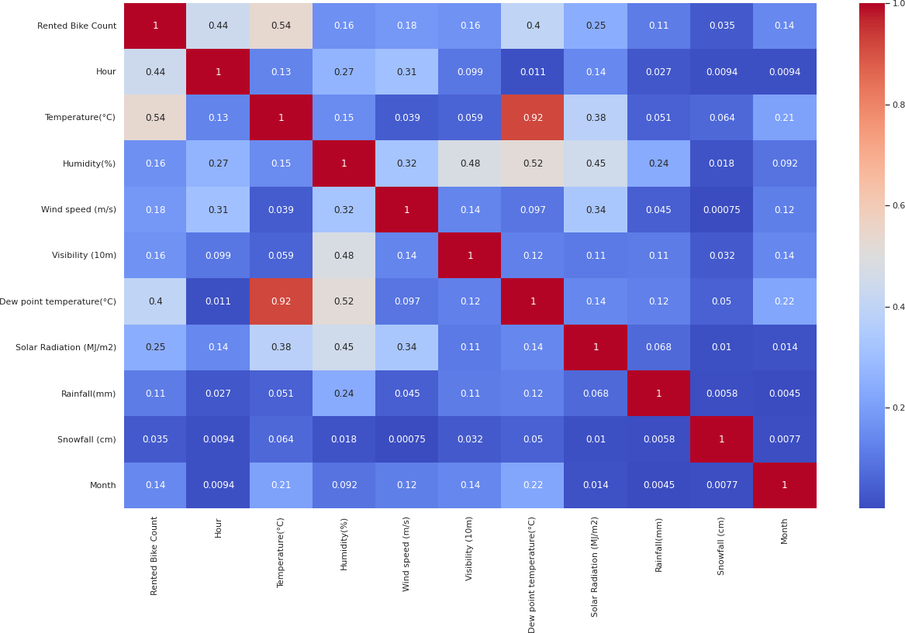
Correlation between Different variables by using Heatmap

Slide 17
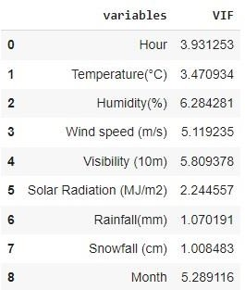
Correlation between Different variables by using Heatmap
Multicollinearity : Dew point temperature, Temperature and Humidity are variables which are highly correlated with each other. We find VIF value of each independent variable .
After dropping dew temperature column,
point VIF
values of each independent
variable are under 10.

Slide 18
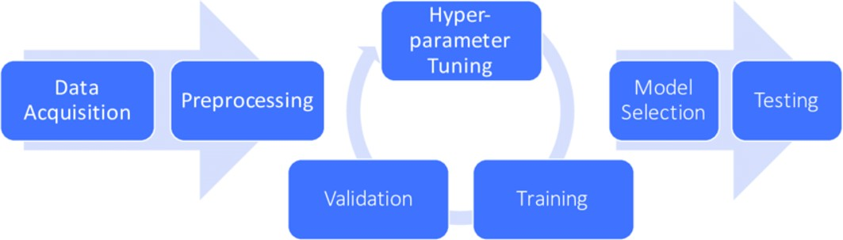
Preparing Dataset for Modelling
Dataset:
Train set: (5385, 12)
Test set: (2308, 12)
Carefully handled feature selection part as it affects R2 score.

Slide 19
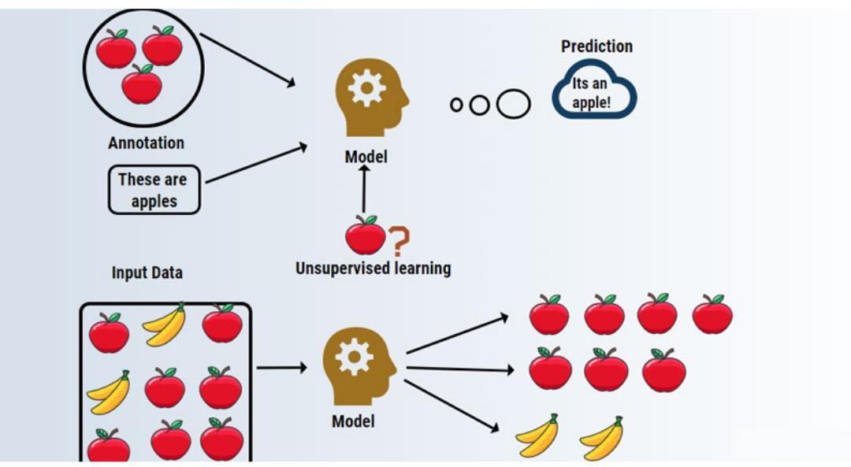
Modeling Overview
Type – Supervised Learning
In this project, we are using six model on our data set for getting best performance :
LINEAR REGRESSION
LASSO REGRESSION
RIDGE REGRESSION
DECISION TREE
RANDOM FOREST
XGBOOST

Slide 20


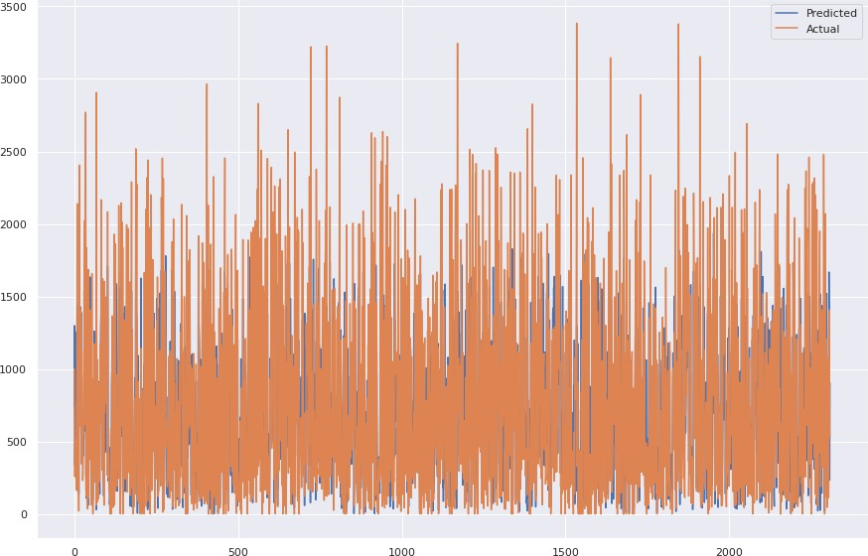

Linear regression
Lasso regression
X`

Slide 21



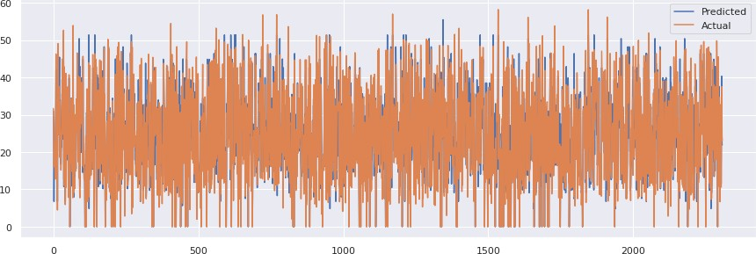
Ridge regression
Decision Tree
X`

Slide 22


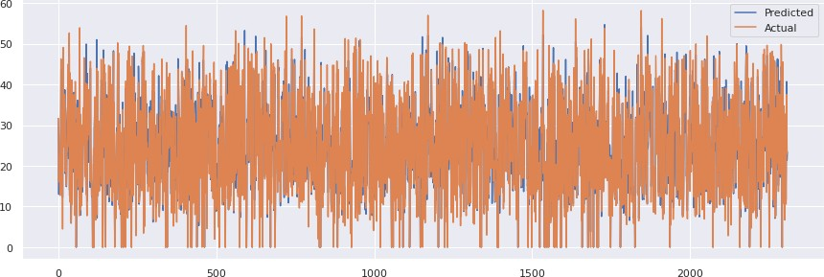
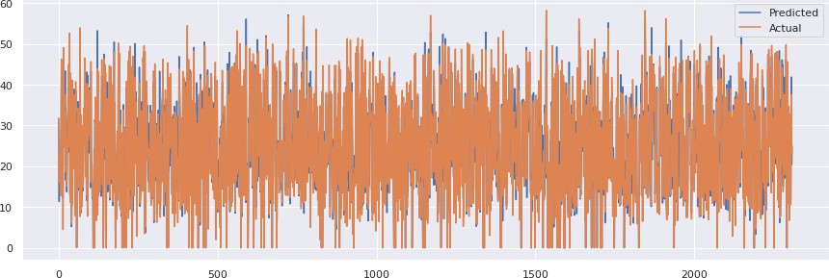
Random forest
XGboost
X`

Slide 23
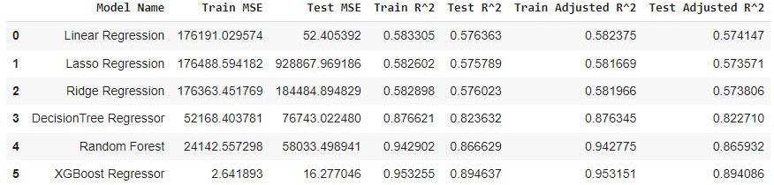
Comparison of different models on the basis of various evaluation matrices
XGBoost outperforms all the other models with r square score of 0.894637.

Slide 24
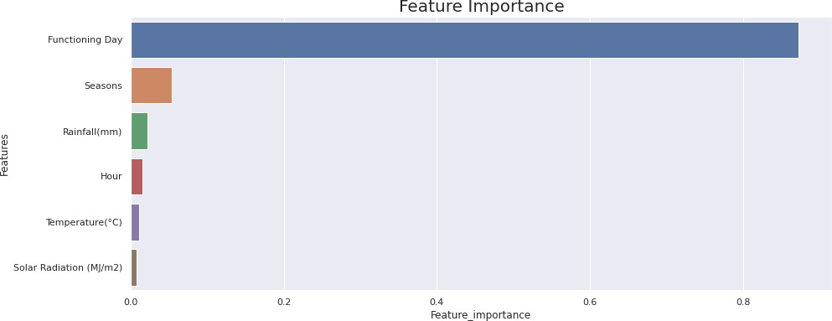
Feature importance with XGBoost model Grid Search-cv
Functional day is the most relevant feature here.

Slide 25

Challenges
Large dataset to handle
Feature engineering
Feature selection - Making sure we don’t miss any important feature.
Careful tuning of hyperparameters as it affects R2 score.
Computation time

Slide 26
Conclusion
We implemented eight M.L. models. After comparing r square and adjusted r square values of all the models, we found that XGBoost has the highest r square values. Also it has least MSE among all models. So, we can conclude that XGBoost is the best model to predict rented bike count.
People prefer borrowing bikes more summer season. Rented bike count is highest in summer and least in winter. Peak demand of bike is at 8am and 6pm i.e. during office opening and closing time.
People prefers to borrow a bike during non- holidays and functional days of the week.
Our model is ready for deployment.

Slide 27


